Slide 1




NEXT GEN EMPLOYABILITY PROGRAM
Creating a future-ready workforce
Team Members
College Name
Student Name : Dayita Jerald
Student ID : au311121104015
Loyola ICAM College of Engineering and Technology

Slide 2

CAPSTONE PROJECT SHOWCASE
Project Title
MUSIC WEB APPLICATION USING DJANGO FRAMEWORK
Abstract | Problem Statement | Project Overview | Proposed Solution | Technology Used | Modelling & Results | Conclusion

Slide 3
Abstract The Music Web Application, built with Django Framework, offers a user-friendly platform for music enthusiasts to explore and enjoy curated music content. Key features include secure user registration, personalized playlists, and a convenient 'Watch Later' option. Leveraging Django's robust backend capabilities and modern frontend technologies, the application delivers a seamless music streaming experience. With an intuitive interface and essential functionalities, it aims to enhance users' music discovery and playback experience. Additionally, the application provides a central hub for music discovery, showcasing curated playlists, trending tracks, and recommended artists on the home page. An 'About Us' section offers insights into the purpose of the application and its creators, fostering transparency and user engagement. Technologically, the project employs a stack comprising Django Framework for backend development, HTML/CSS for frontend design, and possibly JavaScript for dynamic interactions. This combination ensures a well-rounded development environment capable of delivering a responsive and visually appealing user interface.
Source :

Slide 4
Problem Statement The proliferation of digital music consumption has led to a fragmented landscape of music streaming platforms, each with its own set of features and limitations. However, many existing platforms lack a seamless user experience and fail to adequately address the diverse needs of music enthusiasts. There is a need for a comprehensive music streaming solution that combines intuitive user interfaces, robust backend functionalities, and personalized content delivery to enhance the overall music discovery and playback experience. Additionally, existing platforms often overlook the importance of user engagement features, such as bookmarking or 'Watch Later' options, which are essential for facilitating continued interaction and content consumption. Thus, the problem at hand is to develop a Music Web Application using the Django Framework that addresses these shortcomings by providing a user-friendly interface, robust backend infrastructure, and essential features such as secure user registration, personalized playlists, and a convenient 'Watch Later' option. This application aims to bridge the gap in the current music streaming landscape and offer a comprehensive solution for music enthusiasts to explore, discover, and enjoy their favorite music content seamlessly.
Source :

Slide 5
Project Overview User-Friendly Interface: Develop an intuitive and visually appealing interface that allows users to navigate effortlessly through the application. Secure User Registration: Implement a secure user registration system to enable new users to create accounts and access personalized features. Personalized Playlists: Provide users with the ability to create and manage personalized playlists based on their music preferences. 'Watch Later' Functionality: Incorporate a 'Watch Later' feature that allows users to bookmark and access selected music content for later viewing. About Us Section: Include an 'About Us' section to provide insights into the purpose of the application and its creators, fostering transparency and user engagement.
Source :

Slide 6
Proposed Solution
The proposed solution, MusicApp, is a comprehensive Music Web Application developed using the Django Framework. It aims to address the shortcomings of existing music streaming platforms by offering a user-friendly interface, robust backend infrastructure, and essential features tailored to enhance the overall music discovery and playback experience.
Key Features of MusicApp:
User Registration and Authentication: MusicApp includes a secure user registration system, allowing new users to create accounts and access personalized features. User authentication ensures data security and privacy.
Personalized Playlists: Users can create and manage personalized playlists based on their music preferences. The application offers recommendations based on user listening history and interactions.
'Watch Later' Functionality: MusicApp incorporates a 'Watch Later' feature, enabling users to bookmark and access selected music content for later viewing. This feature enhances user engagement and facilitates continued interaction with the platform.
Source :

Slide 7
Interface: The application features an intuitive and visually appealing interface, allowing users to navigate effortlessly through the platform. Clear navigation options and organized content categories enhance the user experience.
About Us Section: MusicApp includes an 'About Us' section, providing insights into the purpose of the application and its creators. This section fosters transparency and user engagement, establishing trust with the user community.
Expected Outcomes:
Successful Implementation of Core Functionalities: MusicApp aims to successfully implement core functionalities such as user registration, authentication, personalized content delivery, and 'Watch Later' feature.
Enhanced User Experience: The application endeavors to deliver an intuitive interface, seamless navigation, and personalized recommendations to enhance the overall music streaming experience for users.x
Scalability and Reliability: MusicApp aims to develop a scalable backend infrastructure capable of handling increasing user traffic while maintaining data integrity and system reliability.
Source :

Slide 8
Additional features:
Social Integration: Integrate social features such as sharing playlists or favorite tracks with friends, following other users, and engaging in discussions or comments on music content. This fosters community interaction and enhances user engagement.
Advanced Search and Filtering: Implement advanced search and filtering options, allowing users to easily discover music based on genres, artists, albums, release dates, and more. Advanced filtering enhances the user experience by providing tailored recommendations.
Cross-Platform Compatibility: Ensure cross-platform compatibility by optimizing the application for various devices and screen sizes, including desktops, laptops, tablets, and mobile phones. This ensures a consistent user experience across different devices.
Source :

Slide 9


Technology Used
Front-end
Back-end
Source :

Slide 10
Modelling & Results Since MusicApp is still in the proposal stage, we can't showcase real-world results. However, here's a breakdown of potential modeling techniques and expected outcomes: 1. Trend Analysis Modeling: Model Type: Time Series Analysis with Anomaly Detection Data Input: Historical and real-time data streams from music streaming services, social media, etc. Expected Outcome: Identify statistically significant spikes in popularity for artists, genres, or songs. 2. Personalized Recommendation Modeling: Model Type: Hybrid Recommendation System (Collaborative Filtering & Content-Based Filtering) Data Input: Listening history (liked songs, playlists), feedback on recommendations, artist/genre attributes. Expected Outcome: Generate personalized recommendations for songs and artists that cater to both the user's established taste and current music trends. Evaluation Metrics: For Trend Analysis: Precision (accuracy of identifying rising trends), Recall (capturing significant portion of emerging trends). For Recommendation System: Click-through rate (user engagement with recommendations), Normalized Discounted Cumulative Gain (NDCG) (ranking quality of recommendations).
Source :

Slide 11
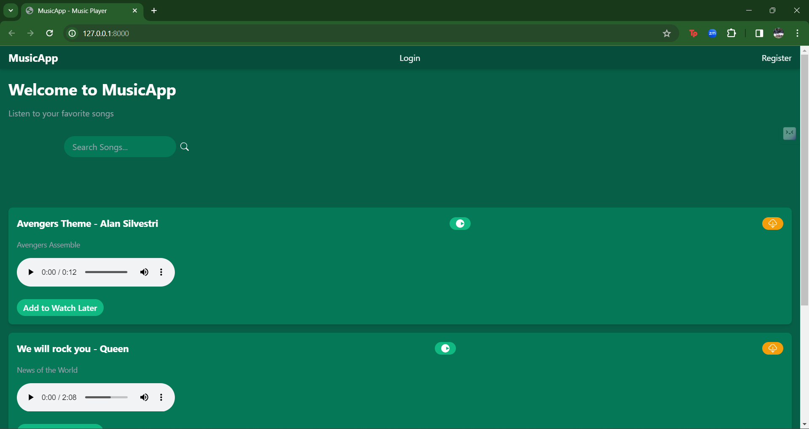
Homepage

Slide 12
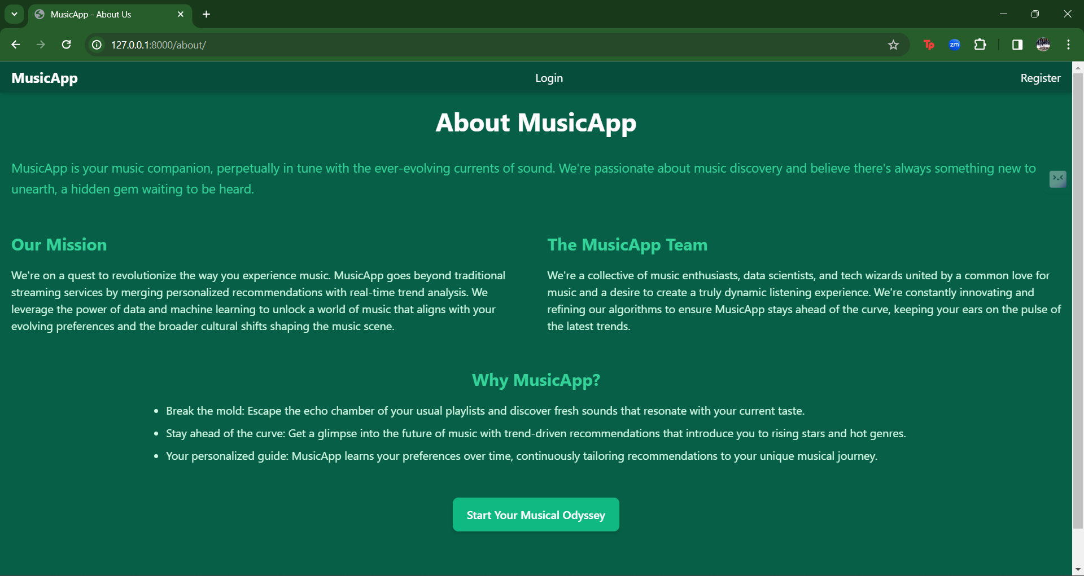
About-Us-Page

Slide 13
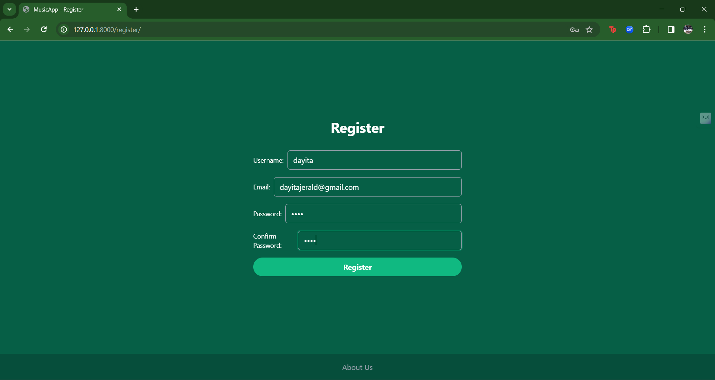
Register Page

Slide 14
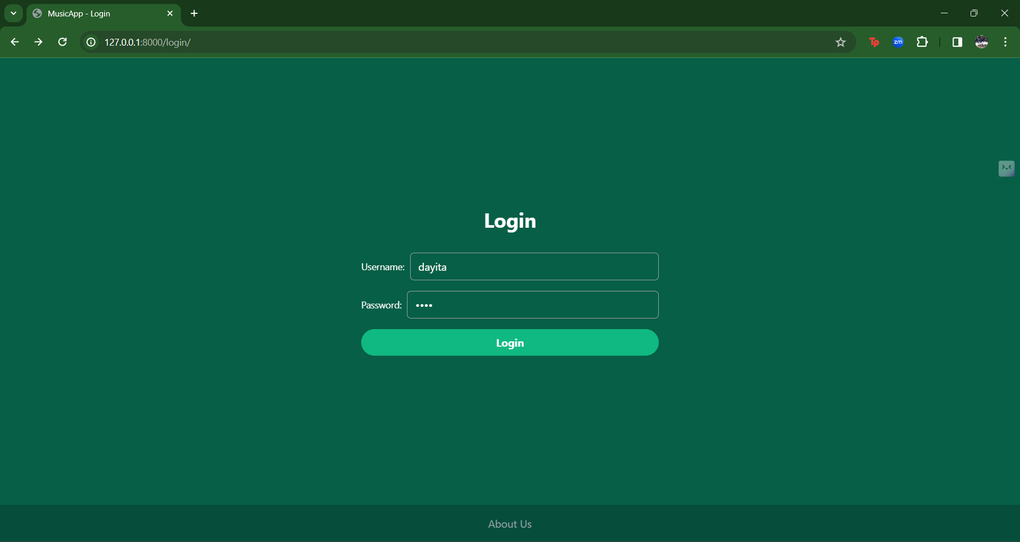
Login Page

Slide 15
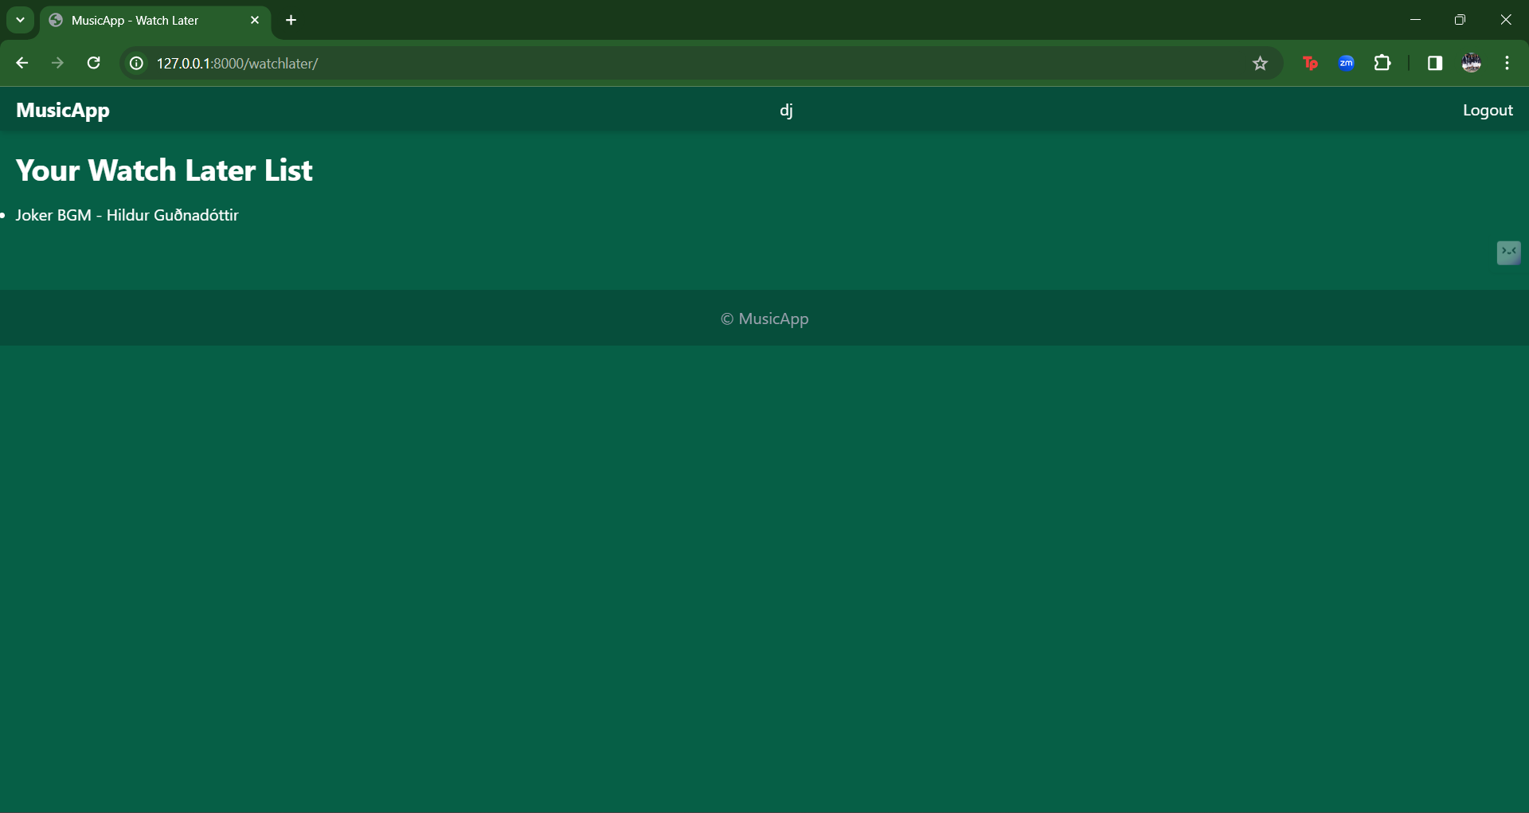
Watch Later Page

Slide 16
Future Enhancements: Offline Mode: Provide an offline mode feature that allows users to download music for offline playback. This feature is especially useful for users with limited internet connectivity or those who prefer to listen to music on-the-go without relying on a stable internet connection. Accessibility Features: Implement accessibility features such as keyboard navigation, screen reader support, and adjustable font sizes to ensure the application is accessible to users with disabilities. Accessibility features promote inclusivity and cater to a wider user base. Personalized Recommendations: Utilize machine learning algorithms to analyze user preferences, listening habits, and interactions to deliver personalized music recommendations. This enhances the user experience by providing relevant content tailored to individual tastes. Content Licensing and Legal Compliance: Ensure compliance with copyright laws and content licensing agreements to provide a legal and ethical music streaming service. Partner with record labels, artists, and content providers to offer a diverse catalog of licensed music content. Feedback and Reporting Mechanism: Implement a feedback and reporting mechanism where users can provide feedback, report issues, or suggest improvements. This helps in gathering valuable insights from users and continuously improving the application based on user feedback.

Slide 17
Data Privacy and Security: Prioritize data privacy and security by implementing robust encryption protocols, regular security audits, and compliance with data protection regulations such as GDPR. Protecting user data instills trust and confidence in the application. Continuous Updates and Maintenance: Commit to regular updates and maintenance to address bugs, introduce new features, and enhance the overall performance of the application. Continuous improvement ensures that MusicApp remains competitive and relevant in the ever-evolving music streaming industry.

Slide 18
Conclusion In conclusion, MusicApp redefines the music streaming experience with its user-friendly interface, robust backend infrastructure, and essential features. Leveraging Django Framework and modern technologies, it offers seamless navigation, personalized playlists, and social integration. Prioritizing scalability, reliability, and data privacy, MusicApp promises to set a new standard in the industry. With continuous updates and commitment to innovation, MusicApp aims to delight music enthusiasts and creators while leaving a lasting impact on the music streaming landscape.
Source :

Slide 19
Thank You!
Notes:
Thank You !!

